Slide 1
Exp.No 7 FDM 3D printer
3D printing is the process of making a physical object from a three-dimensional digital model, typically by laying down many thin layers of a material in succession.
it is also called the additive manufacturing Additive Manufacturing (AM) is an appropriate name to describe the technologies that build 3D objects by adding layer-upon-layer of material as opposed to the subtractive manufacturing such as machining.

Slide 2
Additive Manufacturing
The term Additive Manufacturing (AM) describes a process for rapidly creating an object or part representation before commercial production.
The term AM encompasses many technologies including subsets like 3D Printing, Rapid Prototyping (RP), Direct Digital Manufacturing (DDM), layered manufacturing and additive fabrication
The basic principle of this technology is that a model, initially generated using a 3D CAD model, can be fabricated without need for process planning.
It is fundamentally additive rather than subtractive in nature.

Slide 3
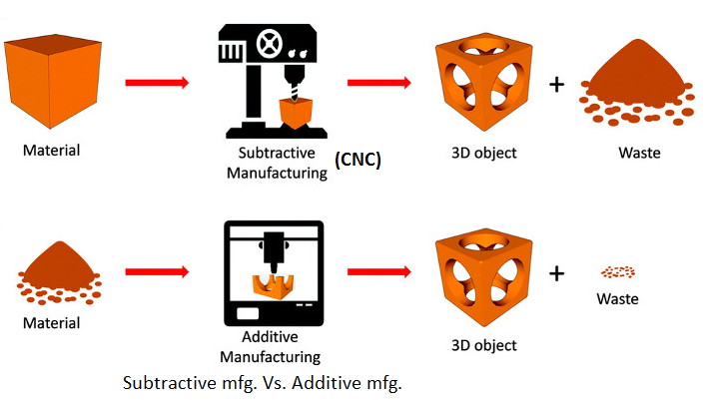
Subtractive vs. Additive Manufacturing

Slide 4
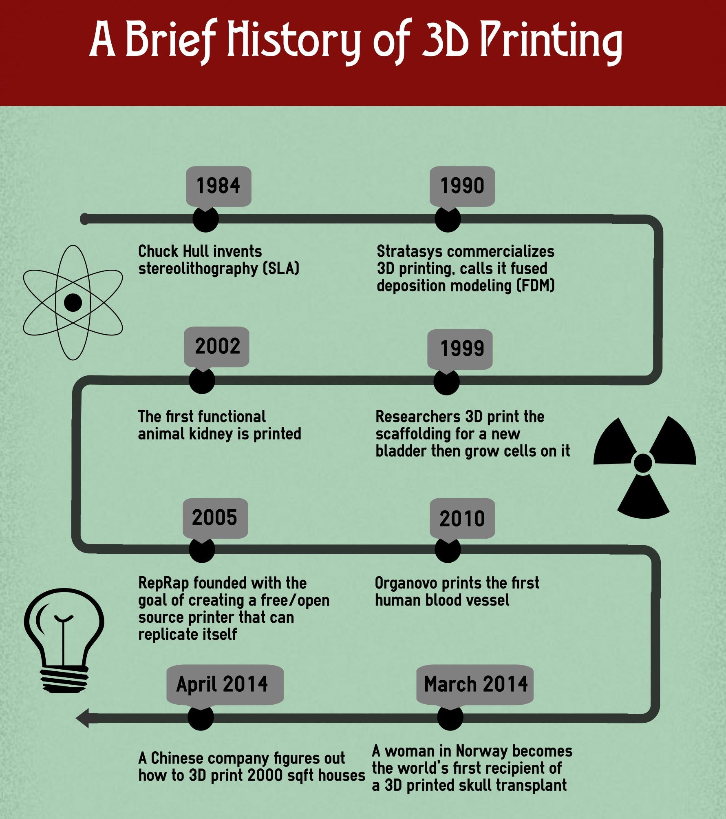

Slide 5
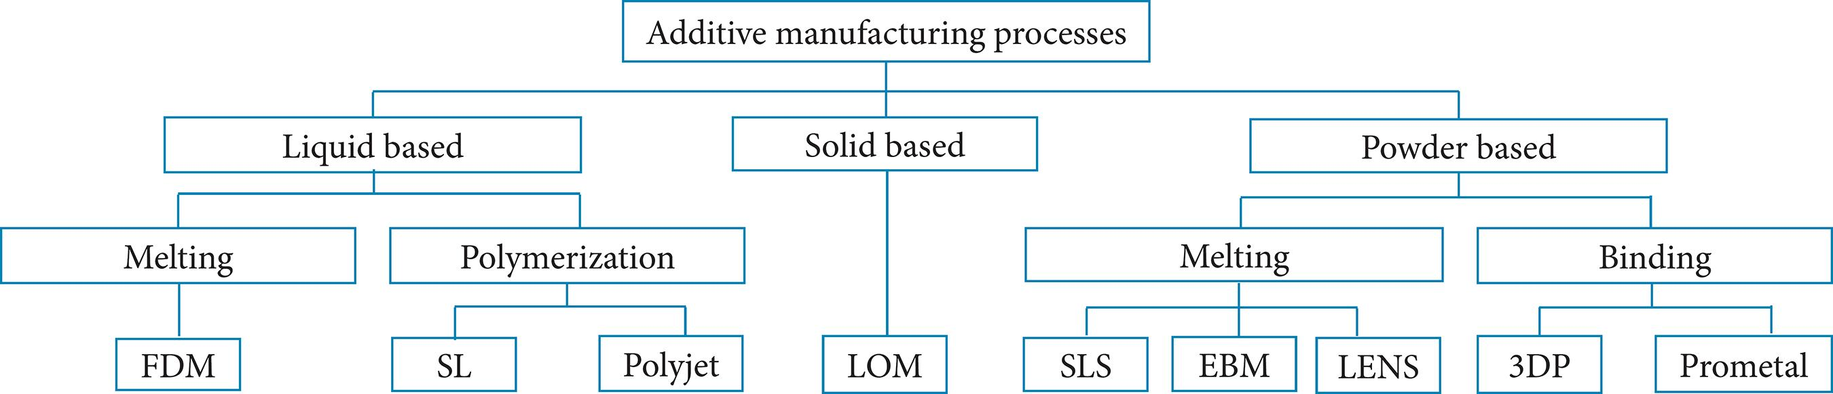
Classification of Additive Manufacturing

Slide 6
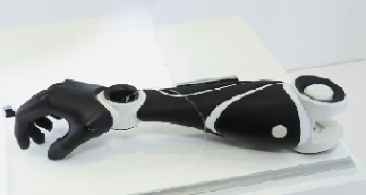
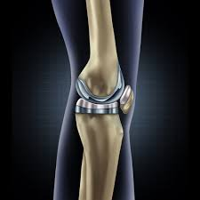
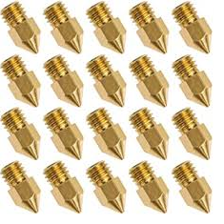
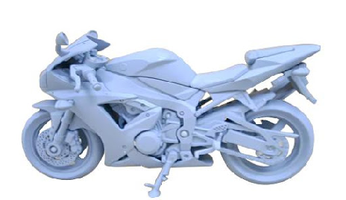
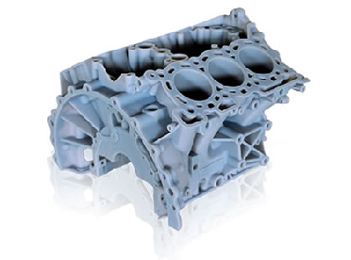
Applications of Additive manufacturing

Slide 7
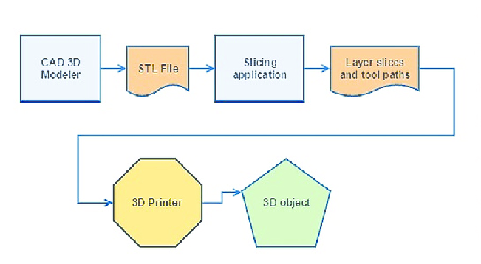
Steps in 3D printing

Slide 8
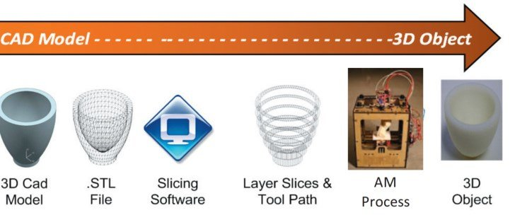
Steps in 3D printing

Slide 9
Advantages of 3D printing
1. Flexible Design:3D printing allows for the design and print of more complex designs than traditional manufacturing processes.
2. Rapid Prototyping
3D printing can manufacture parts within hours, which speeds up the prototyping process. This allows for each stage to complete faster
3. Print on Demand
Print on demand is another advantage as it doesn’t need a lot of space to stock inventory, unlike traditional manufacturing processes. This saves space and costs as there is no need to print in bulk unless required.

Slide 10
Advantages of 3D printing
4. Strong and Lightweight Parts
The main 3D printing material used is plastic, although some metals can also be used for 3D printing. However, plastics offer advantages as they are lighter than their metal equivalents. This is particularly important in industries such as automotive and aerospace where light-weighting is an issue and can deliver greater fuel efficiency.
5.Minimising Waste:
The production of parts only requires the materials needed for the part itself, with little or no wastage

Slide 11
Advantages of 3D printing
Advanced Healthcare
3D printing is being used in the medical sector to help save lives by printing organs for the human body such as livers, kidneys and hearts.

Slide 12
Limitations of 3D printing
Materials generally have low strengths.
Material prices are far too high restricting the growth of the market.
Parts are generally not as dense as parts made by CNC and other processes.
Printers are not fast enough.
Manufacturing complex parts or organic parts needs a lot of 3D modeling training
Limited Materials.

Slide 13
FDM 3D printer
Fused Deposition Modeling (FDM) or Fused Filament Fabrication (FFF), is an additive manufacturing process that belongs to the material extrusion family. In FDM, an object is built by selectively depositing melted material in a pre-determined path layer-by-layer.
The materials used are thermoplastic polymers and come in a filament form.FDM is the most widely used 3D Printing technology: it represents the largest installed base of 3D printers globally and is often the first technology people are exposed to.

Slide 14
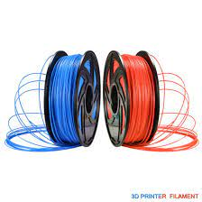
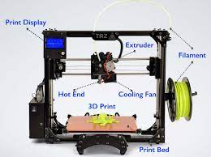
FDM 3D printer

Slide 15
Construction of FDM printer
FDM involves 3 main parts: a printing plate on which the part is printed; a filament coil that serves as printing material, and an extrusion head, called an extruder. The filament is melted by the extruder of the printer, which deposits the material layer-by-layer on the plate.
The 3D modelling process involves designing the object using a CAD 3D software (such as SolidWorks, Tinker CAD or Self CAD). Once designed, the 3D model (likely a .STL file) is split into many layers through a ‘slicer’ (such as Cura or Repetier) before the parameters of the printing are chosen.

Slide 16
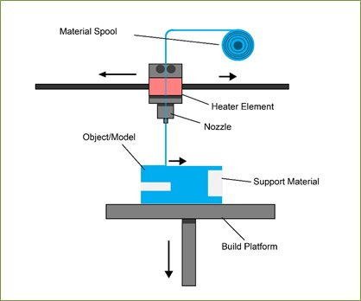
Construction of FDM printer

Slide 17
Construction of FDM printer
1.Filament :Filament is used for the FDM 3D printers. Filaments are available in spools. These are heated to certain temperature and are liquefied to be deposited on the print bed. This happens in layers.
The objects created by 3D printers are made of these filaments. There are many types of filaments used for 3D printing. And, each one of them have different properties. They have their own advantages and limitations.
When getting a printer, one must take care of the compatibility with different filaments. Not all printers allow multiple filament compatibility. Some can process only one kind of filaments, mostly PLA. And, others can work with multiple choices of filaments including PLA, ABS and many others

Slide 18
Construction of FDM printer
2.Motion contorllers: you must know that the 3D printers, as the name suggests works along the three axes. Motion controllers receive instructions from the mother board about the movement they must make, while they are the ones who perform the actual movements.
3.Print Bed :Different 3D Printers have different kinds of print bed. You can find heated as well as non-heated print beds. A non heated print bed may be enough for PLA, however, for advanced filaments, heated beds are recommended. These helps in enhancing adhesion and stability for first layer of the print.

Slide 19
Construction of FDM printer
4. Extruder: The extruder itself is made of different parts.
The Filament Drive Gear: Also known as extruder drive gear is responsible for pushing the filament into the hot end.
The Heat Sink: The heat sink along with the heat Sink Fan ensures that the material is still in solid state until it reaches the nozzle.
The Heater Cartridge: This is the component that works to heat up the filament.
The Thermocouple: To maintain the right temperature, the extruder uses a temperature sensor. This is used for the hot end.
The Cooling Fan: Once the melted filament is deposited, it must be cooled down for setting before the next layer gets deposited. The job of the cooling fan is to ensure the same.

Slide 20
Construction of FDM printer
for deposition. There are different sizes of nozzles that the printers use. 0.4 mm is the most common one. By keeping the smaller diameter of nozzle, one can achieve finer details with greater accuracy. And, larger nozzle helps in printing at a higher speed..
6. Feeder system: There are two most common feeder system used in 3D printers: Bowden feeder system and Direct feeder system. In a Bowden setup, there are different locations for cold and hot ends. While a filament tube is used to direct the filament towards the hot end. This setup can dramatically increase the print speed as the extruder becomes lighter.

Slide 21
Construction of FDM printer
When talking about the direct setup, the cold end and the hot end are directly connected. The direct feeder system is most common among the users who work with flexible filaments.
7.Print Display :These days, most of the 3D printers, even the budget ones, comes with an LCD user interface. With the help of this interface, one can control the printer settings without a need for computer.

Slide 22
Working of FDM 3D printer
1.A spool of thermoplastic filament is first loaded into the printer. Once the nozzle has reached the desired temperature, the filament is fed to the extrusion head and in the nozzle where it melts.
2. The extrusion head is attached to a 3-axis system that allows it to move in the X, Y and Z directions. The melted material is extruded in thin strands and is deposited layer-by-layer in predetermined locations, where it cools and solidifies. Sometimes the cooling of the material is accelerated through the use of cooling fans attached on the extrusion head.

Slide 23
Working of FDM 3D printer
3. To fill an area, multiple passes are required . When a layer is finished, the build platform moves down (or in other machine setups, the extrusion head moves up) and a new layer is deposited. This process is repeated until the part is complete.

Slide 24
Materials used in FDM 3D printer
PLA stands for Polylactic Acid and it’s the classic filament people 3D print with. PLA is a biodegradable and bioactive thermoplastic polyester that is made from natural products like corn starch, making it more environmentally-friendly compared to other plastics
PET :Polyethylene terephthalate is a thermoplastic polymer resin of the polyester family. It’s combined from two monomers and used widely for almost everything – from bottles to clothes.
PETG is different to PET with that one letter, “G”, which stands for Glycol that is added to the material. It is a clear amorphous thermoplastic that improves PET by making it stronger and more durable

Slide 25
Materials used in FDM 3D printer
ABS is short for Acrylonitrile butadiene styrene and it’s an amorphous polymer used in 3D printing. ABS is usually produced through the emulsion process from 3 components or recycled from itself. It’s widely used in producing a multitude of everyday goods like your keyboard keycaps. ABS is used when parts require extra strength; however, some improved composites are slowly starting to displace it

Slide 26
Advantages and Limitations of FDM 3D printer
Advantages of FDM printer: Comparatively lower cost, Broad range in materials, Consumes less time, Ease of use
Limitations of FDM 3D printer: FDM lays down layers much like hot glue coming out of a glue gun, this often leads to ribbing, and you can see lines from each layer. An extra step of polishing or sanding can be added to remove these lines. Supports may be required, Part strength is weak perpendicular to build axis, and temperature fluctuations during production can lead to separation of layers.

Slide 27
Applications of FDM 3D printer
FDM printed parts are used for massive amount of applications across industries. From prototype to final parts companies in automobiles, aerospace, medical, maritime, and railway have already adopted FDM as a manufacturing process.

